Slide 1
Pressure Control System
Eng Ahmed Maher

Slide 2
1. Case Study
A pressure controller informs the crew of a cabin with an alarm when the pressure exceeds 20 bars in the cabin
The alarm duration equals 60 seconds.
keeps track of the measured values.
Pressure Controller: Assumptions
The controller set up and shutdown procedures are not modeled
The controller maintenance is not modeled
The pressure sensor never fails
The alarm never fails
The controller never faces power cut
Versioning • The ”keep track of measured value”
option is not modeled in the first version of the design

Slide 3
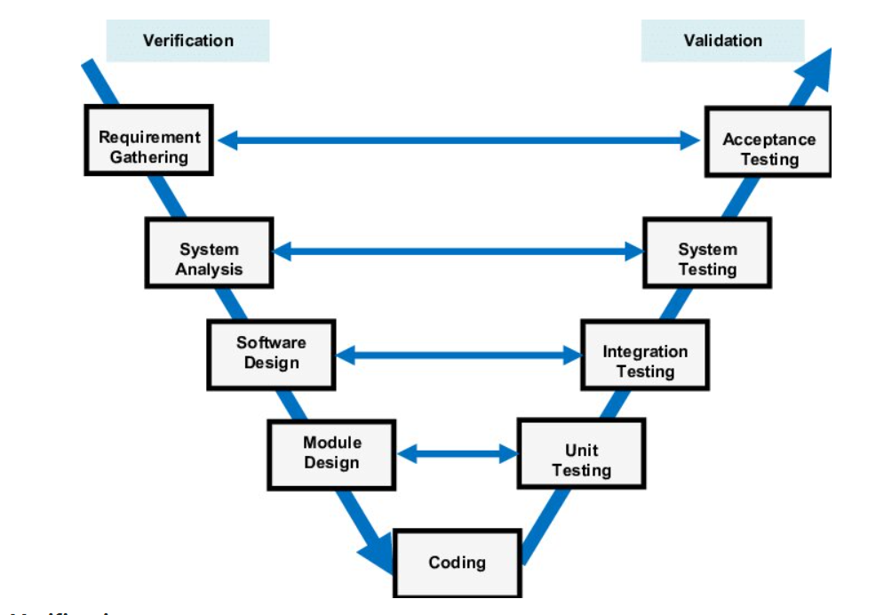
Method
V Module

Slide 4
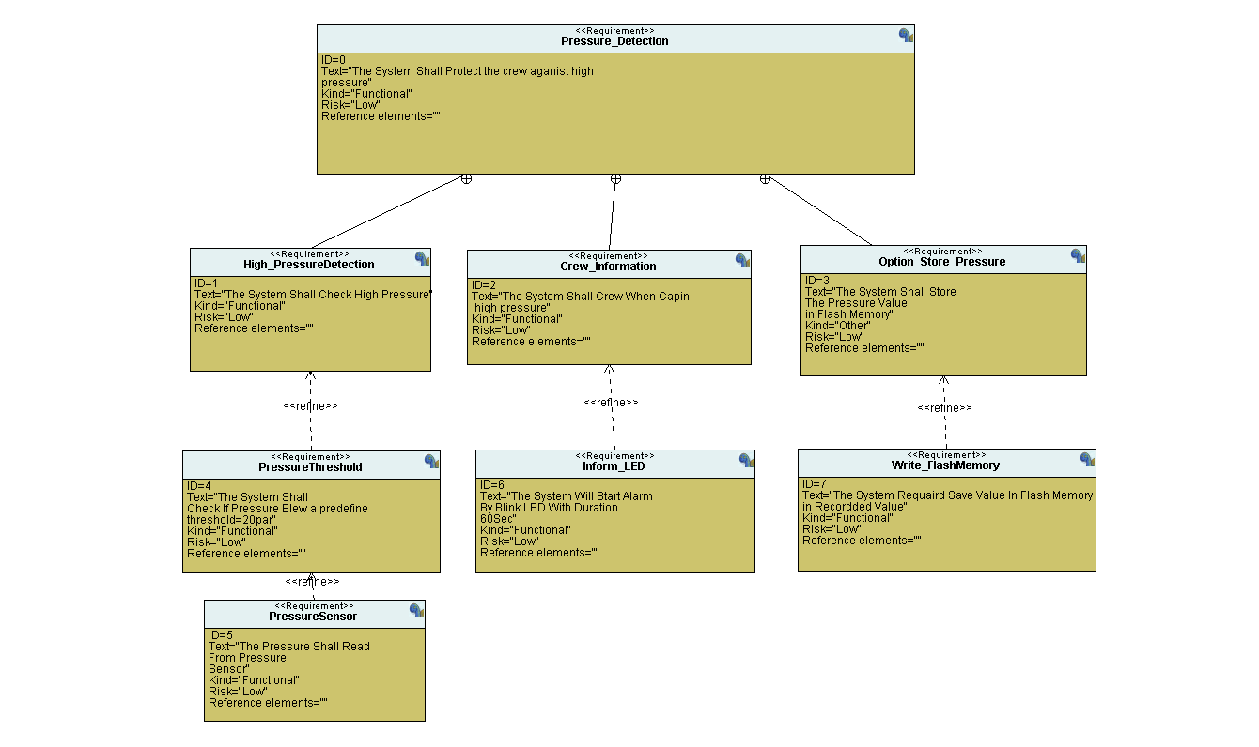
Requirement

Slide 5
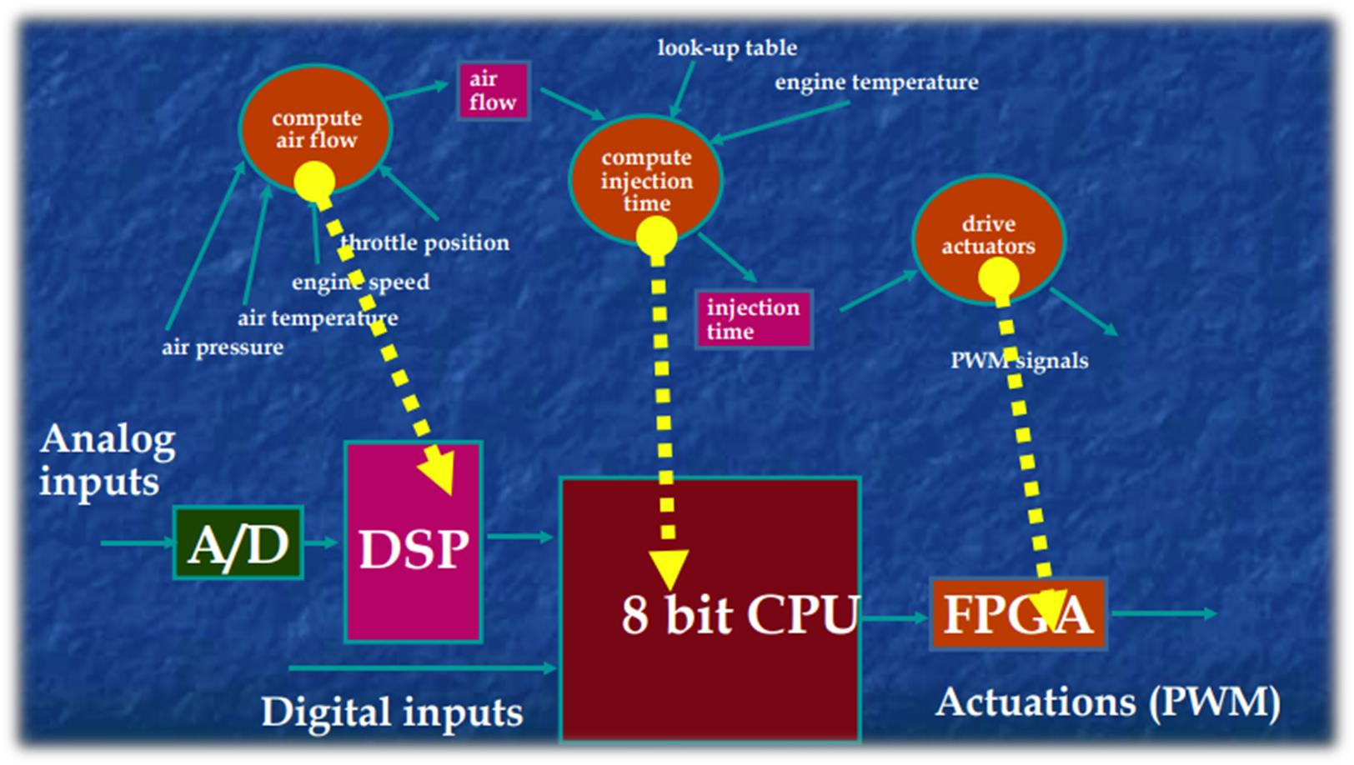
Space Exploration / Partitioning
3 Task Implementation
Target : STM32F103xx
Compute airflow → DSP
Compute injection Time → CPU
Drive Actuators → FPGA

Slide 6
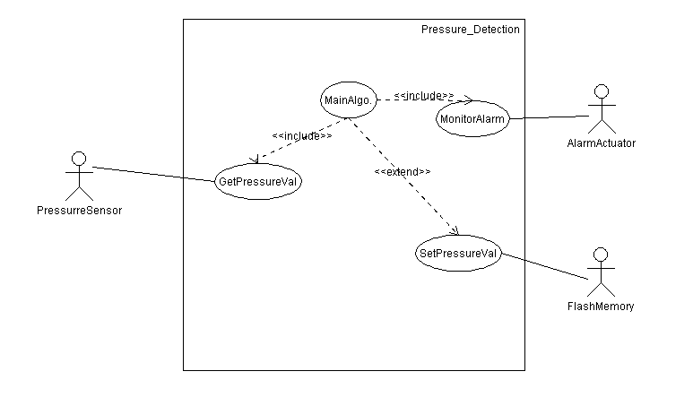
System Analysis
1- Use Case Diagram

Slide 7
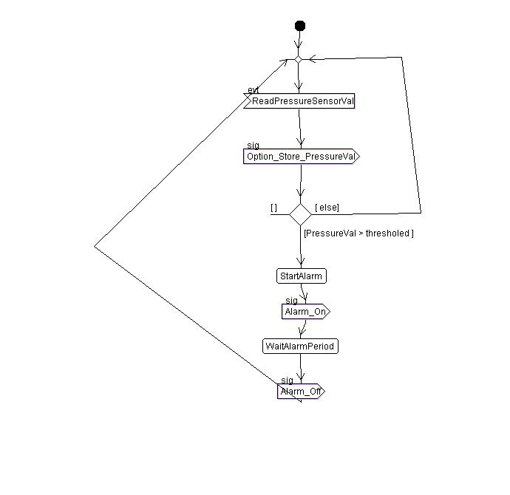
2-Activity Diagram

Slide 8
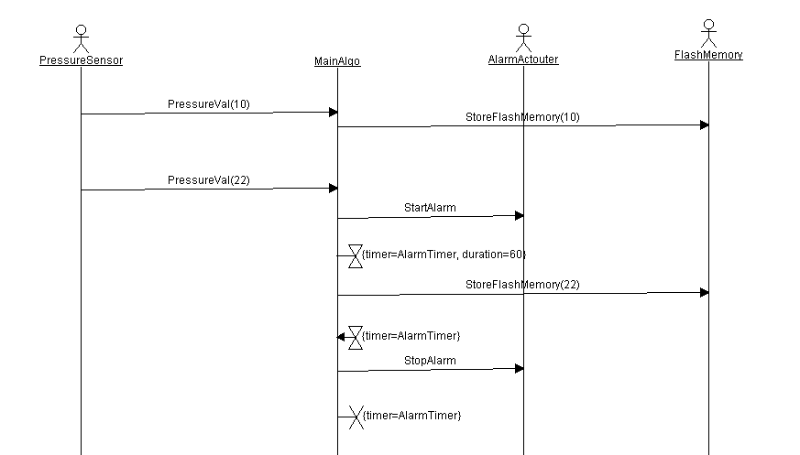
3-Sequance Diagram

Slide 9
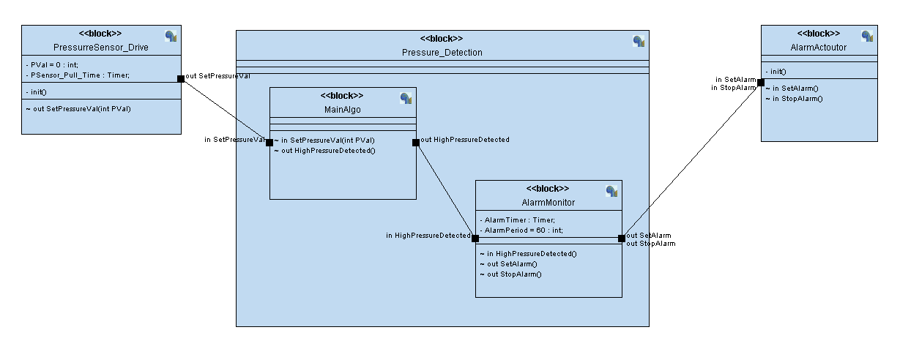
4-Block Diagram

